Slide 1
Presentation On WebStore Application
Presentation By:
Ritesh Maharjan
Rajendra Maharjan
Saugat Pageni
Supervisor: SiAMak Tavakoli
Course: Software Architecture
Maharishi International University
FairField, Iowa, 52557

Slide 2
Project Summary
Design Class Diagram, Domain Diagram and Component Diagram
Created Customer Service, Product Service, Cart Service, Cart Query Service and Order Service
Configure the zipkin, kafka, zookeeper and kafka magics
Created Config Server
Created the Registry Server and failover registry server for fallback
Created the API Gateway with building in Circuit Breaker
Created the load balancing service for ProductService
Created REST template

Slide 3
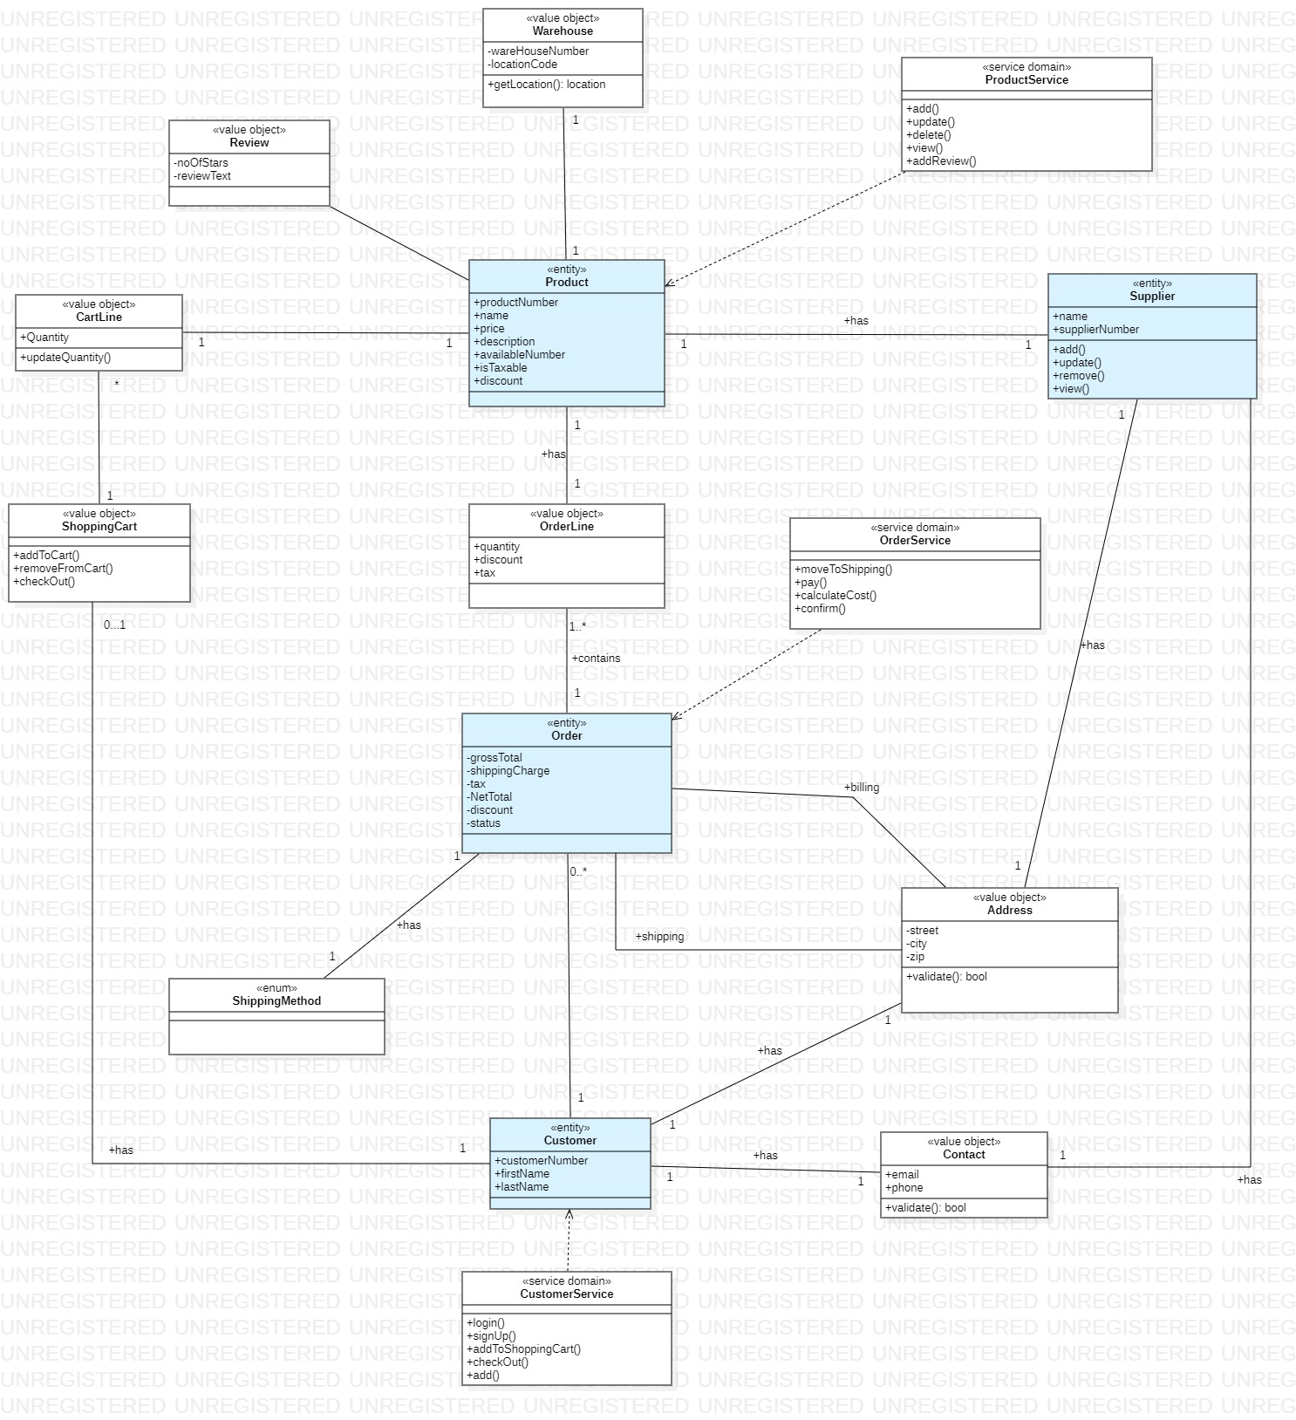
Class Diagram

Slide 4
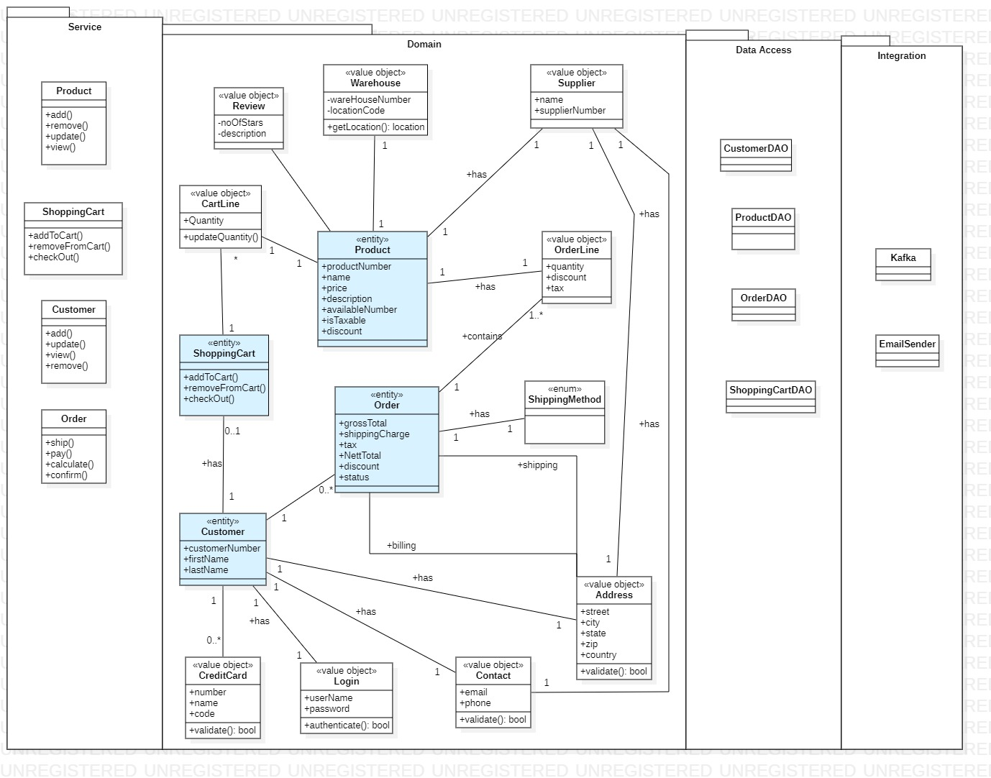
Domain Diagram
Entities
Customer
Product
Shopping Cart
Order
Value Object
Review
Warehouse
Supplier
OrderLine
Address
Contact
ShippingMethod

Slide 5
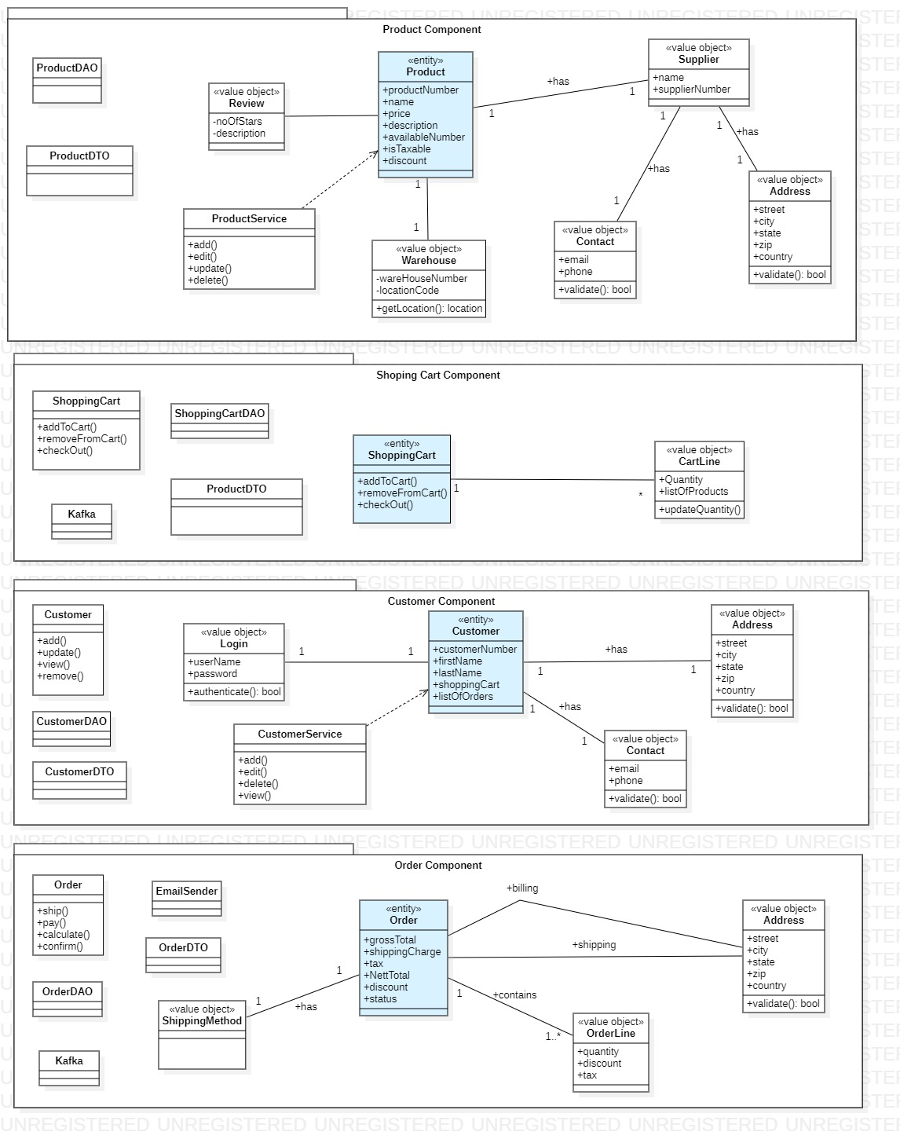
Component Diagram
Product Component
Order Component
Shopping Cart Component
Customer Component

Slide 6
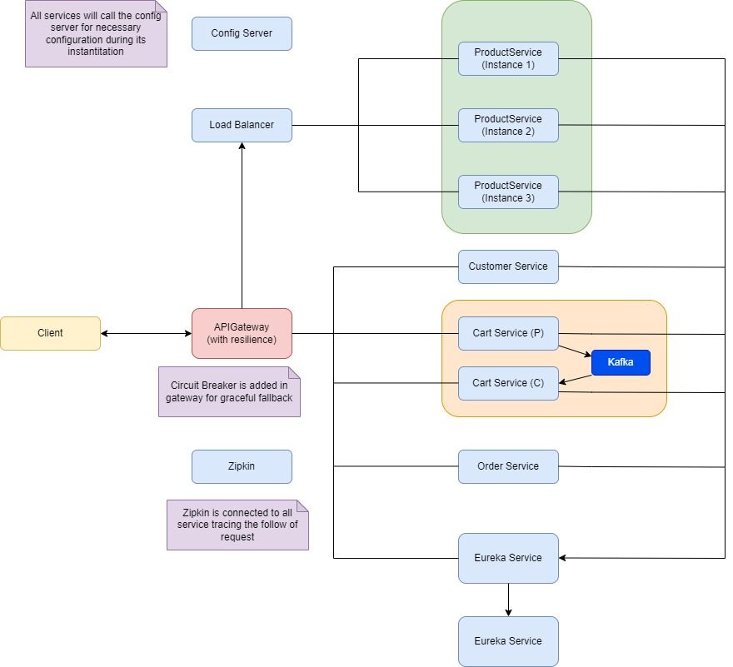
Service Architecture Design

Slide 7
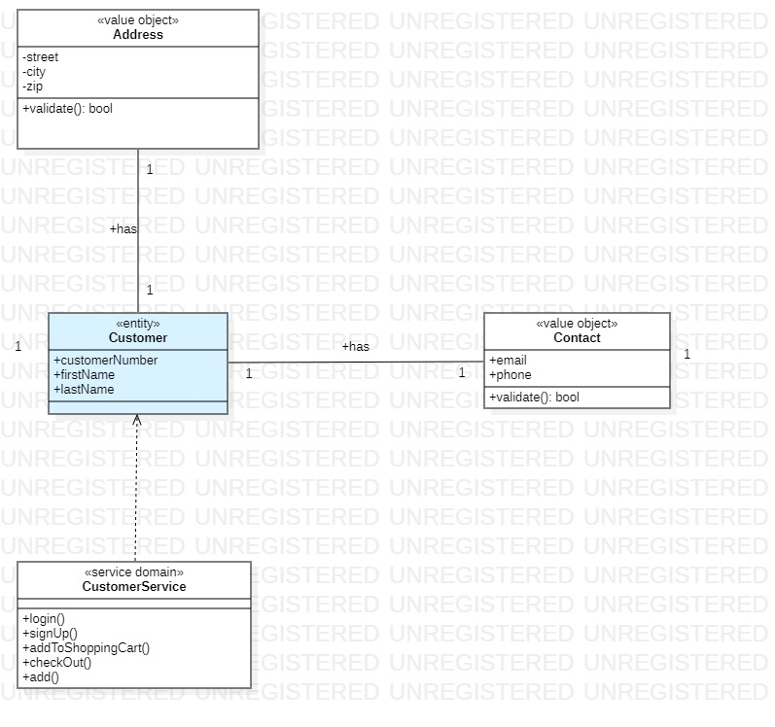
Customer Service
Embodied functionalities
Add
Remove
View
List
Update
Domain Object
Customer
Value Objects
Address
Contact

Slide 8
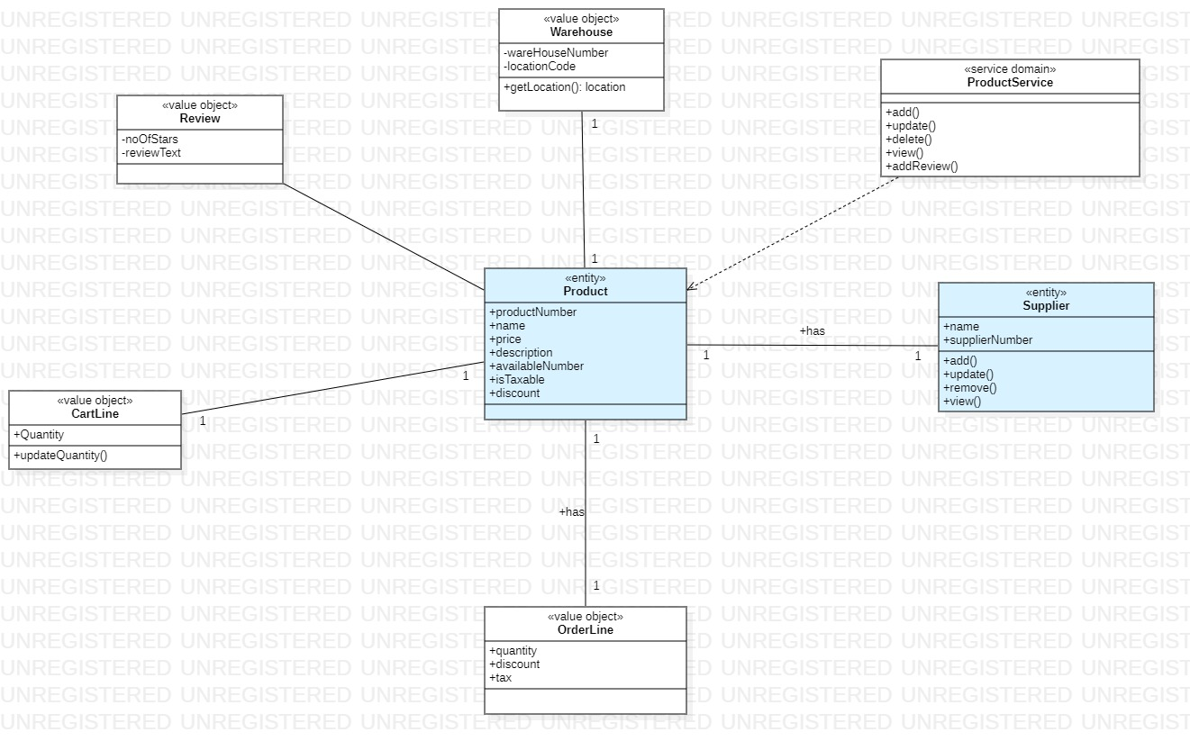
Product Service
Embodied functionalities
Add
Remove
View
List
Update
Domain Object
Product
Supplier
Value Objects
Address
Contact
Warehouse
Review
Cartline

Slide 9
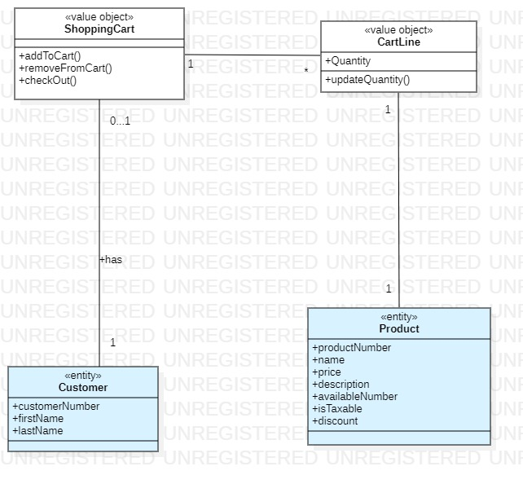
Shopping Service
Embodied functionalities
Add product
Remove
View
List
Update product
Checkout
Domain Object
ShoppingCart
Customer
Product
Value Objects
CartLine

Slide 10
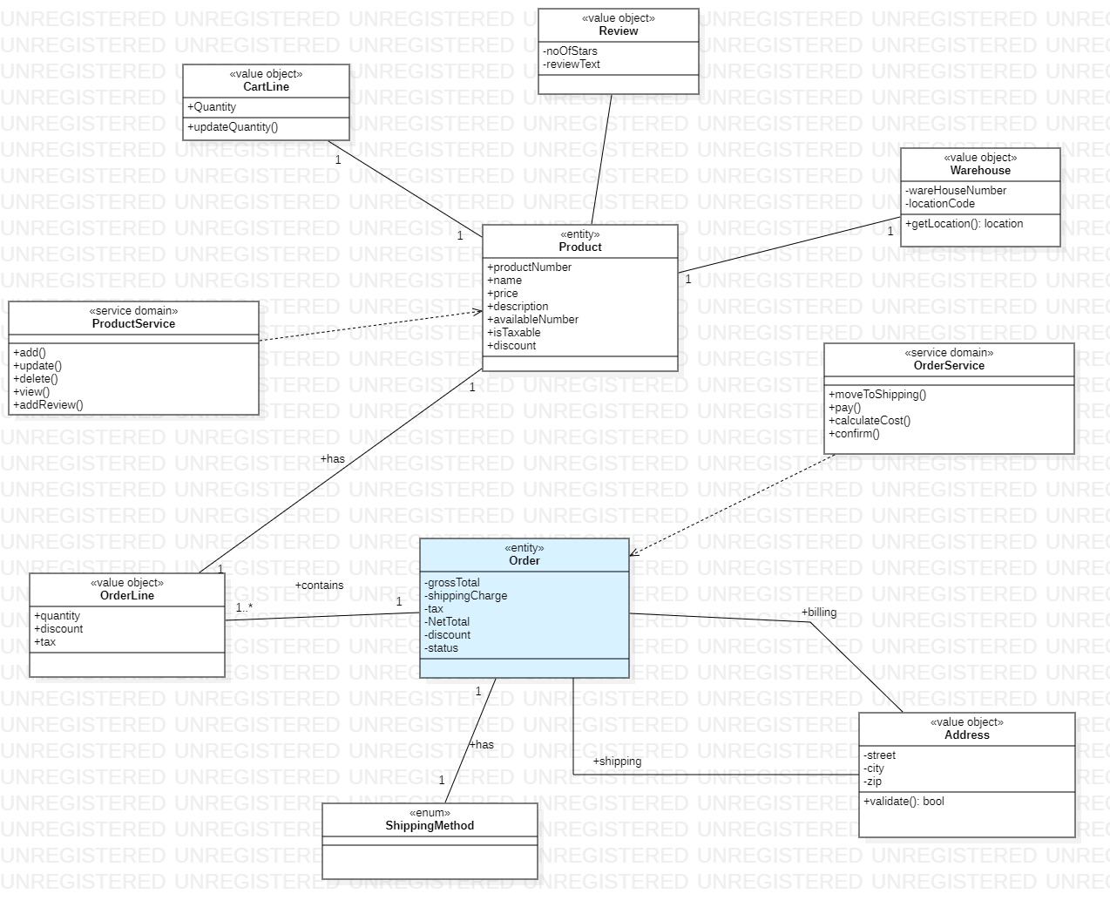
Shopping Service
Embodied Functionalities
Add product
Remove
View
List
Update product
Checkout
Domain Object
ShoppingCart
Customer
Product
Value Objects
Cartline

Slide 11
Patterns Used
Config Server
Eureka Registry Service and it’s failover management
API Gateway
Resilience
Load Balancer
Distributed Tracing
CQRS and Event Sourcing
Kafka Messaging Pattern

Slide 12
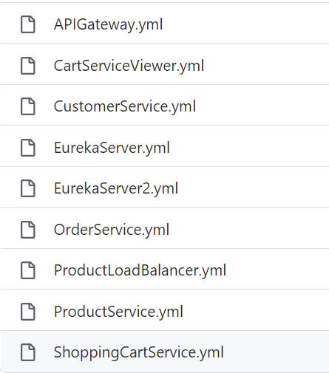
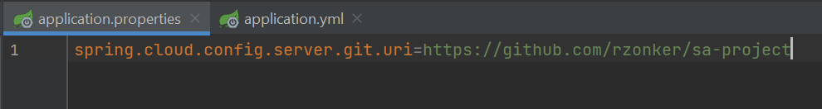
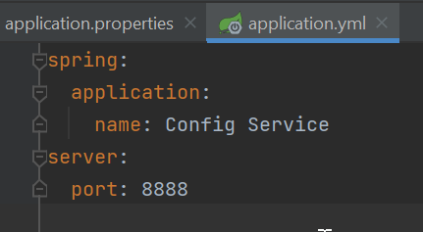
Config Server
External configuration service
Removes configuration from code
Used Git for maintaining configuration files

Slide 13
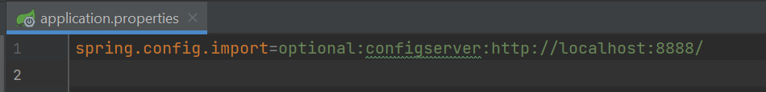
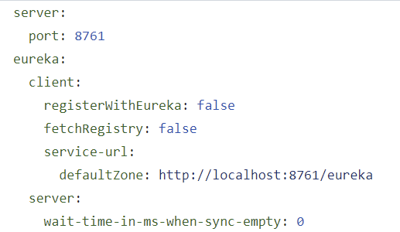
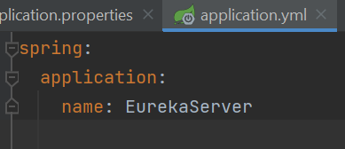
Registry Service
Like a phone directory
Holds an information of the client and it’s location
Clients registers themselves and read from register server
Resgistry server does regular health check

Slide 14
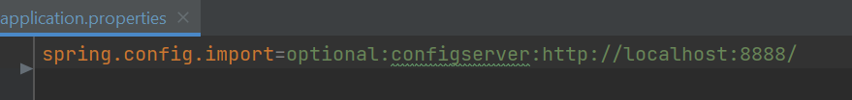
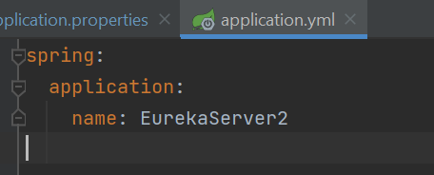
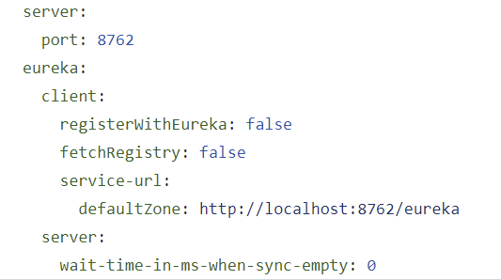
Eureka Failover
Ensures high availability

Slide 15
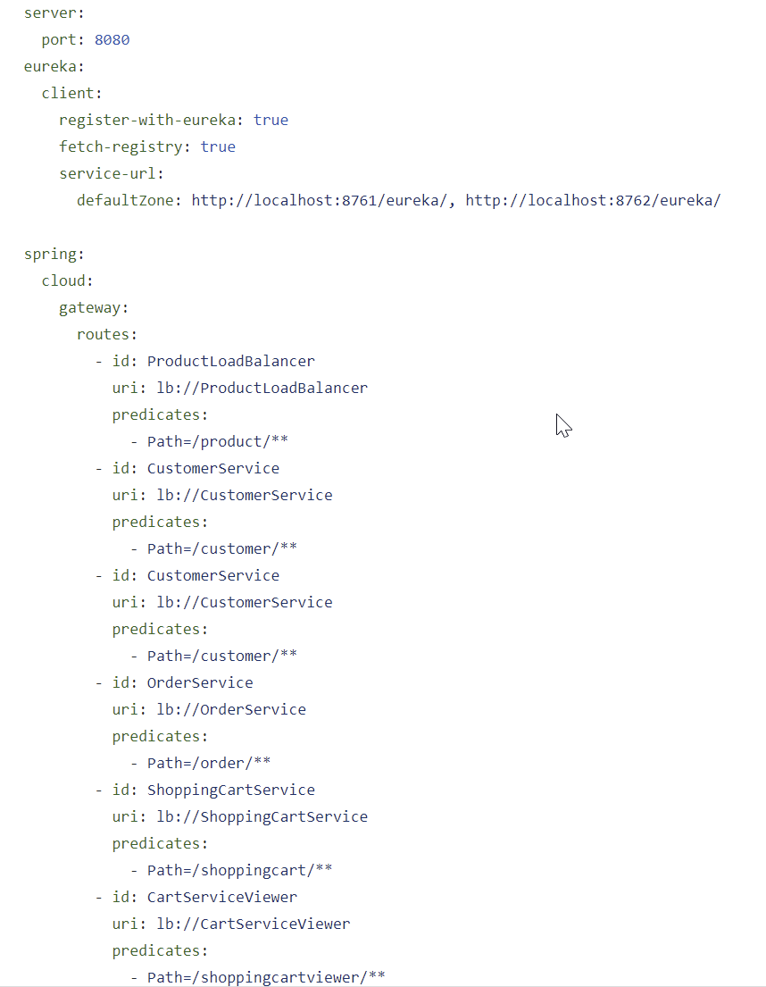
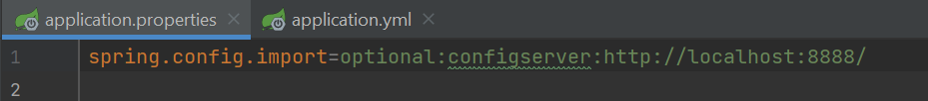
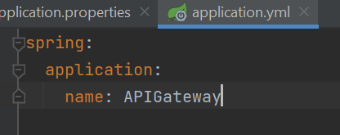
API Gateway
Offers proxy to redirect or route request to endpoint
Act as a single endpoint for client applications
Can have pre-, post-, error-, and route- filter

Slide 16
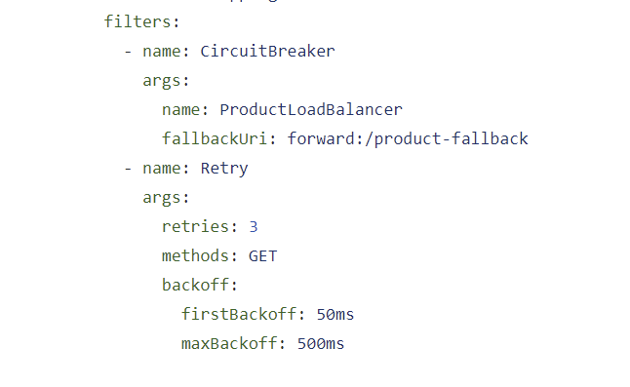
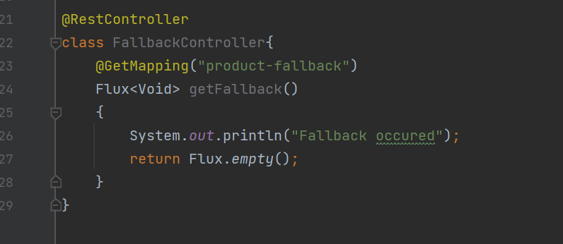
API Gateway – Resilience
Eureka server cannot handle the chatty communication
Resilience help to tackle this via circuit breaker
Configuration for circuit breaker is shown here

Slide 17
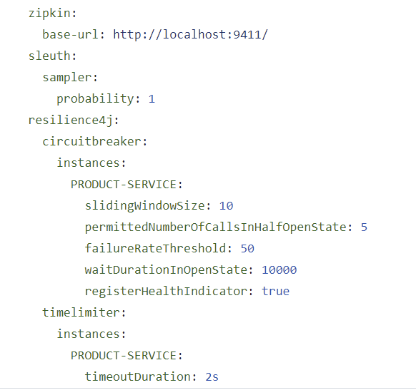
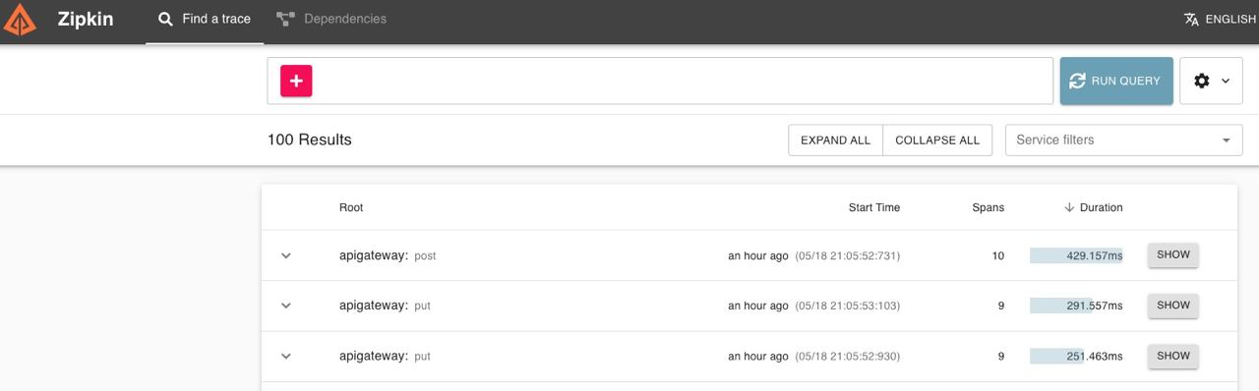
Zipkin and Sleuth
Use for tracing the request
Uses span id and trace id
Configuration to placed in services is shown here

Slide 18
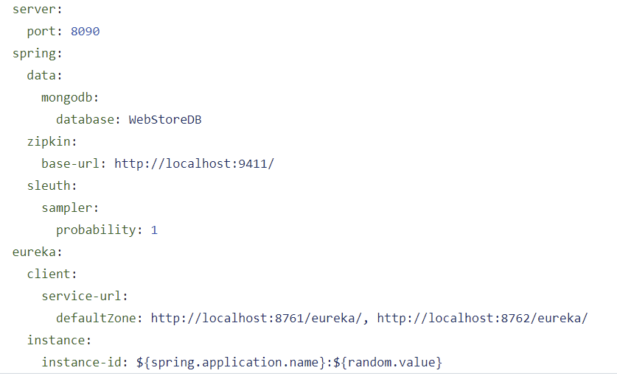
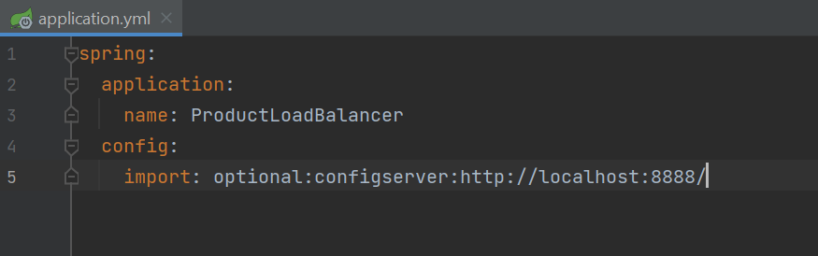
Load Balancer
Help to control the traffic to a service
By default Round Robin is used
If one service gets down then other one will be used
Ensures high availability

Slide 19
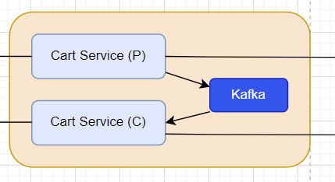
CQRS and Event Sourcing
Separated the command and query
Cart Server acts as a command service and produces the message to kafa
Cart Viewer acts as a query service and consumer the message from kafka

Slide 20
Challenges
Kafka
We had faced challenges in syncing the object between Producer and Consumer
For solution, we had used the string message, which is the json format of the object
ELK
We tried to configure the ELK in project but were not able to configure the logstash

Slide 21
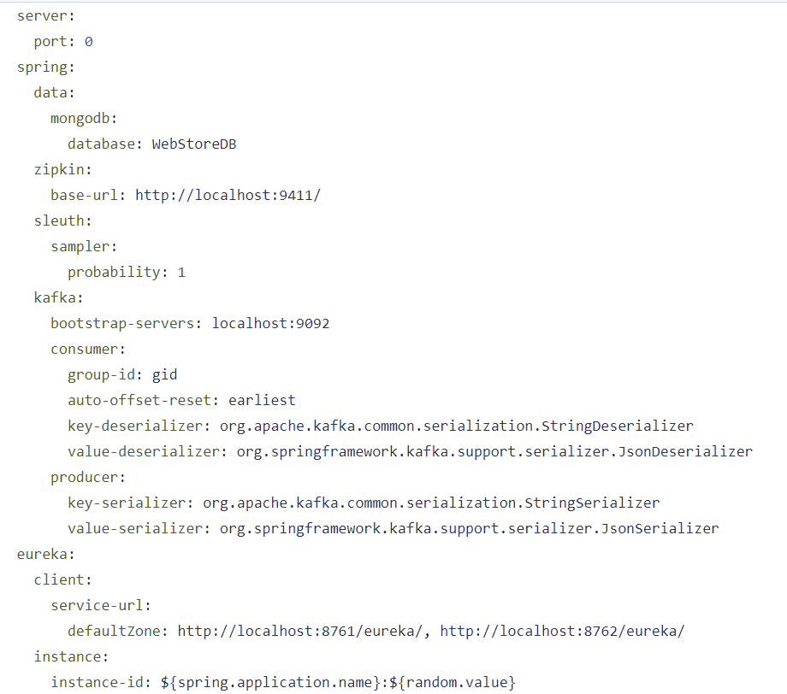
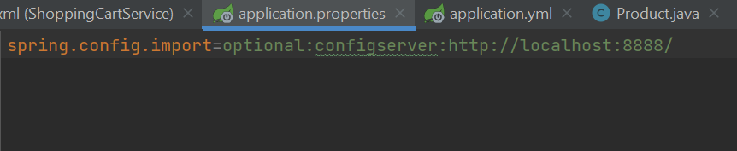
Cart Service (Command)
Service to handle
Add product
Remove product
Change quantity
Checkout cart
On checkout it produces the event

Slide 22
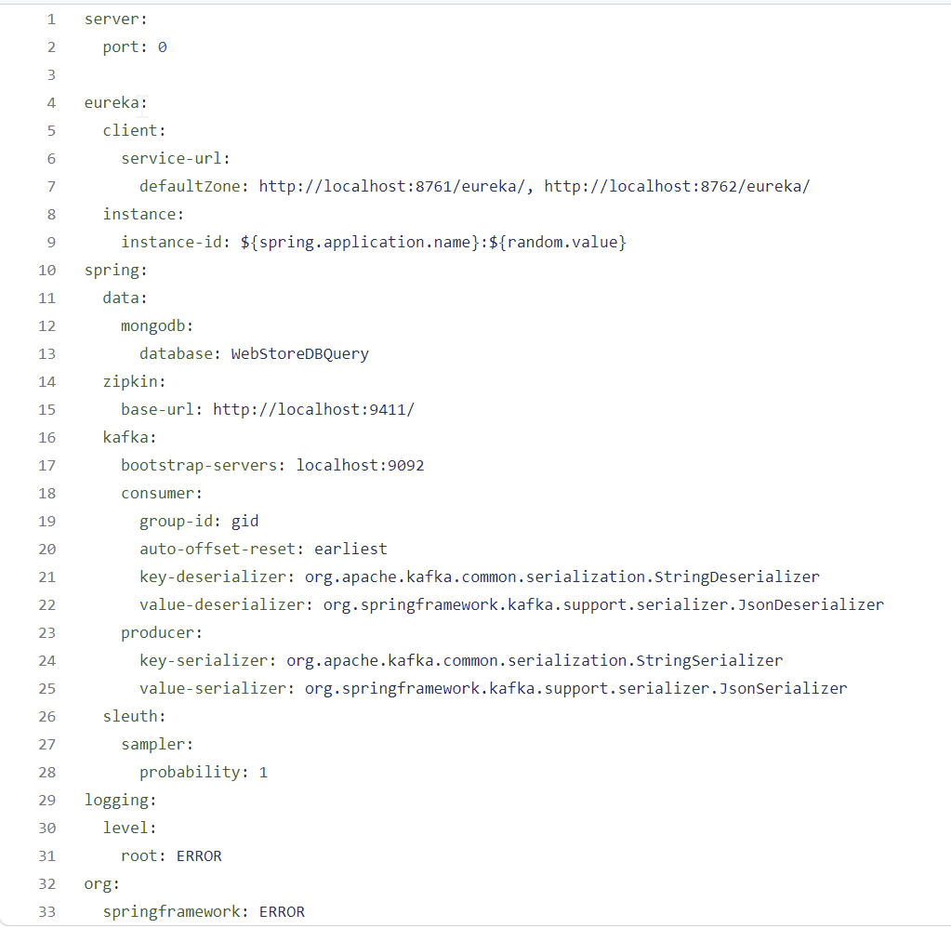
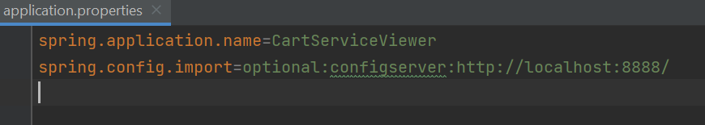
Cart Service (Query)
Service to handle
Listen to event produced by Command Cart Service
Saves and update changes in cart to separate database
Handles queries related to view carts

Slide 23
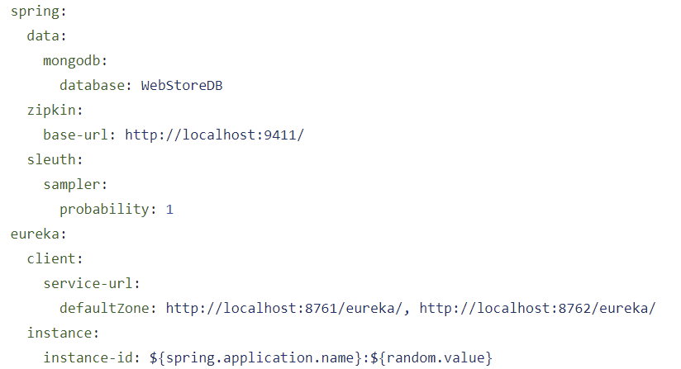
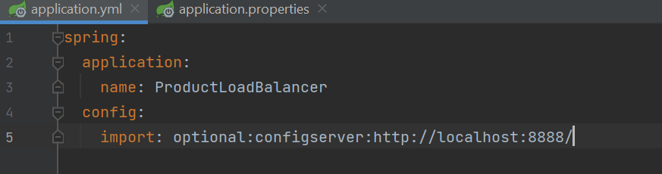
Product Service
Service to handle
Add product
Remove product
View prodct

Slide 24
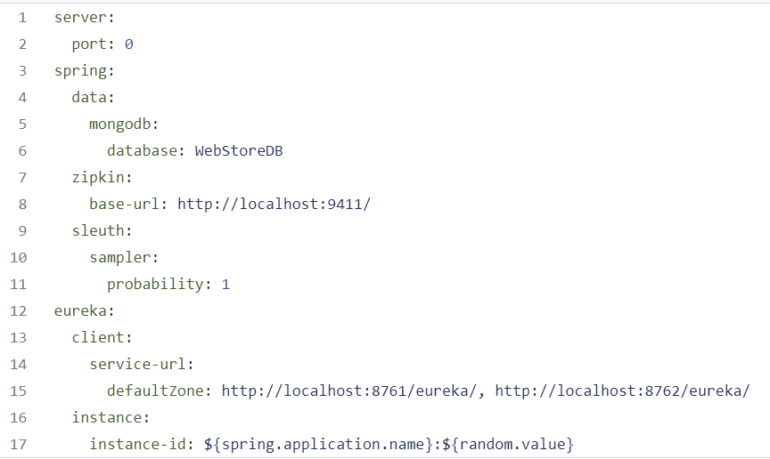

Customer Service
Service to handle
Add Customer
Remove Customer
View Customer

Slide 25
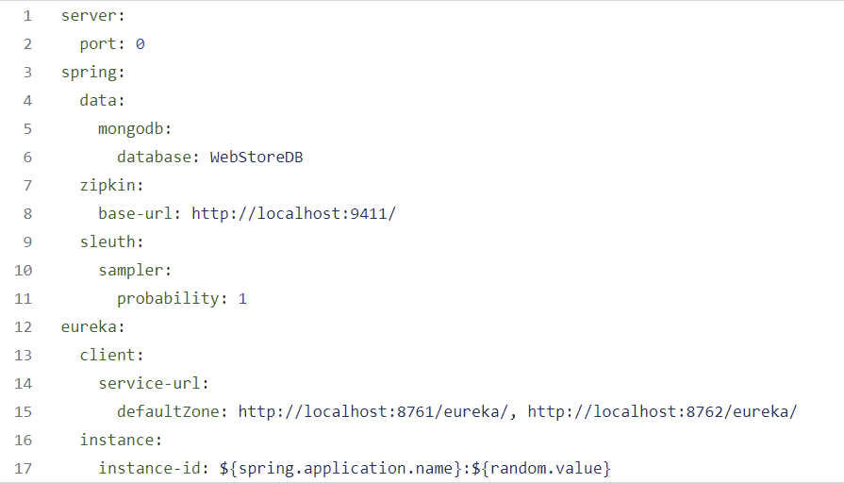
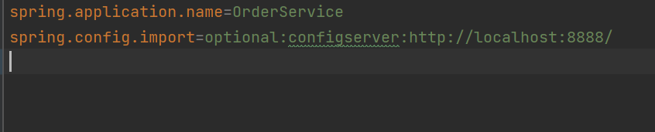
Order Service
Service to handle
Create order
View order

Slide 26
THANK YOU

